Slide 1
DESIGN THINKING- 22CDT21
TEAM-6
VEHICLE PARKING SYSTEM
TEAM 6 : FUTURE VISIONARIES
TEAM MEMBERS:
MALINI.R-22CSR115
JAYAVARDHINI.R-22CSR082
KOWSALYA.D-22CSR103
KAJOL SUSHMITHA.K-22CSR084
MADHUVANTHI.M-22CSR110
KOKILA DEVI.P-22CSR102

Slide 2
PHASE 1: EXPLORE
T 1: SCOPE TOOLS

Slide 3
 | SCOPES | DEFINITION
S | SITUATION AND/OR PROBLEM | Primary challenges in a parking system is having limited space to accommodate all the vehicles, especially in crowded urban areas.
C | CONSTRAINTS | The most basic constraint is the availability of parking spaces.
O | OBJECTIVES AND OUTCOMES | The system should provide a convenient and user-friendly experience for drivers, allowing them to easily find parking spaces and navigate within the parking facility.
P | PEOPLE | Security,Vehicle owners.
E | ESTIMATES | Arduino,IR sensors,Servo motors,Jumper wires.
S | SCOPE | The system should facilitate smooth entry and exit of vehicles by providing automated gates, barriers, and sensors.

Slide 4
T 2 : STEEP TRENDS ANALYSIS
SOCIAL & DEMOGRAPHICS TECHNOLOGY ECONOMY ENVIRONMENT & NATURE POLITICAL & LEGAL
IT IS VERY USEFUL FOR SOCIALIZED
ENVIRONMENT
EFFICIENTLY MANAGE AND OPTIMIZE PARKING SPACES
SAVING LIFE SAVES THE ECONOMY OF THE LIFE
EFFECTIVENESS AND SUSTAINABILITY FOR THE ENVIRONMENT
SEVERAL RESTRICTIONS ARE MANDATORY AND TO BE INCLUDED IN THE LAW.
OUR
CHALLENGE ISSUE

Slide 5
T 3: Strategic Priorities Matrix.
Urgent
Less Urgent
Important
Less important
Implement security measures such as surveillance cameras and well-lit areas to deter theft and vandalism. | Implementation of advanced security features like CCTV surveillance and automated alarm systems may not be immediately urgent
Implementing advanced payment methods like mobile apps are less important | Implementing a system that helps users locate their parked vehicle within the parking facility, especially in large parking lots or garages.

Slide 6
T 4: Stakeholder Mapping Matrix.
T
High Interest / Low Influence High Interest / High Influence
Low Interest / Low Influence Low Interest / High Influence
Giving information about whether the slot is available are not.
Giving alert message and sharing slot location to the drivers.
Giving information about the slots to the driver where the vehicle is parking.
If the slot is full,display there is no space available.

Slide 7
T 5: Reframing the Opportunities.
s
Agency’s
Perspectives:
Municipal Local government
Transportation Deparments
Opportunities:
1.smart parking solution
2.sustainable parking solutions
3.Automated and robotics parking system
4.Contactless payments and access control
Systems’s
Processors
perspectives
User’s
perspectives
H
M
W
A vehicle parking system is designed to efficiently manage and organize the parking of vehicles within a specific area, such as a parking lot or parking garage. The system uses various technologies and processes to help drivers find available parking spaces, facilitate entry and exit, and streamline payment procedures
“STEEP” Trends
Analysis

Slide 8
.
PHASE II - EMPATHISE
T 6: POEMS FRAMEWORK

Slide 9
POEMS FRAMEWORK | FIELD VISIT AND ONSITE OBSERVATION | INSIGHTS
People:Who are involved?What roles do they play?How are the people engaging with each other? | Technology providers,Payment processors | Customers
Objects:What artifacts are important? What roles do they play?How are the people engage with each other? | Legal and Regulatory Bodies | Security staff,Transport authorities
Environment:Where is the action taking place?What is happening?What are the people doing? | An efficient and user friendly parking system environment | Checks parking availability and rates
Message & Media:What are the messages and communication media used? | Some parking system provides notification or updates | Payment remainders,time limited parking notification
Services:What are the services and support systems provided? | Via phone,email | Live chat to users to assist users with any issues
.

Slide 10
T 7:EMPATHY MAP-TO GENERATE INTERVIEW QUESTION
What does user hear from others? What do friend and family say? Who influence the user and how? What communication channels are influential? | What does the user think & feel? What is really important to the user? What drives the user? What worries the user? What are user’s aspiration? | What does user see? What does it look like? Who surrounds the user? Who are the user’s friend? What problem does the user encounter? | What does the user say?do? What is the user attitude? What could the user be telling others? Are there conflicts between what the user say/do and truly think & feel?
PAIN? For fitting the sensor for each slot | What barrier and challenges does the user face? What are the user’s frustrations? | GAIN? Easy to find the parking slots and it reduces time. | What makes user happy or satisfied? What gives user motivation?
.

Slide 11
T 8 :JOURNEY MAP (interview questions.)
User realizes the need for parking (e.g., arriving at a destination, looking for parking).
User sees signage for the parking system, app, or website.
User accesses the parking system's app/website for information.
User chooses to make a reservation (if available) or decides to visit the parking facility directly.
User follows navigation directions to the selected parking facility.
User navigates within the parking facility to find an available spot.
User arrives at the parking facility entrance.
User parks the vehicle in the selected spot.
User prepares to leave the parking facility.
User reflects on their parking experience.

Slide 12
T 9:Post Interview De-brief Presentation
Summary profile of the interview:
Goals and Motivation: car parking system aims to provide a better experience for users by offering convenient and user-friendly features. This may include features like real-time information on available parking spaces, automated payment systems, and streamlined entry and exit processes. | Aspiration : The aspiration is to provide drivers with real-time information about available parking spaces, including their locations, occupancy status, and pricing. This information can be accessed through mobile applications, digital signage, or vehicle navigation systems, allowing drivers to make informed decisions and find parking quickly and conveniently
Current experience: Some modern parking systems use technology such as sensors or cameras to detect and display available parking spaces, making it easier for drivers to find an open spot. | Challenges and pain points: Security is a significant pain point for parking systems. Theft, vandalism, and unauthorized access to vehicles are common challenges.
Memorable things in interview: 1.Innovations and Future Outlook. 2.Problem-Solving Scenario. 3.Technical Knowledge Assessment. | User inputs and deep needs: 1.User identification. 1.Availability of parking spots. 2.Vehicle details. 2.Convenience and ease of use. 3.Duration of parking. 3.Security and safety. 4.Payment information. 4.Guidance and directions.

Slide 13
T 10: SAMPLE NEED STATEMENT
The absence of parking sensors results in a Lack of real-time data regarding parking space availability,which leads to inefficient utilization of parking areas.
Without accurate information,the parking person often resort to circling around parking lots or city streets,causing unnecessary traffic congestion and environmental pollution.
The vehicle parking sensors provides accurate information to drivers.Additionally,the data collected from these sensors can be utilized to optimize parking space allocation, improve parking lot management.
This technology would significantly enhance the parking experience for drivers,alleviate traffic congestion,improve environmental sustainability,and optimize the utilization of parking resources in urban areas.

Slide 14
T 11: PERSONA CANVAS
PERSONA CANVAS
PERSONA NAME: SURESH.
Deep need statements:
Parking system that offer additional amenities or services can be motivating factors
Demographic profile:
Age:40-50
Gender:male
Home:
Family:Married.
Education background:10th
Goals:1.Ensure the safety and security of his vehicle while parked.
Motivation:1 Parking systems that offer additional amenities or services can be motivating factors.
Behavior:
Friendly character,soft and kind.
challenges:1.Insufficient
space utilization.2.Traffic flow and congestion.
3.Manual payment.

Slide 15
.
PHASE III- EXPERIMENT
T 12: SCAMPER WORKSHEET

Slide 16
S | Substitute | Consider substituting different components or elements of the parking system with alternatives
C | Combine | Think about ways to combine various features or technologies to enhance the parking system
A | Adapt | adopting the concept of "smart cities" to develop an interconnected parking infrastructure that communicates with vehicles and drivers.
M | Modify | Identify existing elements of the parking system that can be modified or tweaked to make it more efficient or user-friendly
P | Put to other uses | Explore how certain elements of the parking system can be repurposed to serve different functions.
E | Eliminate | Identify existing elements of the parking system that can be modified or tweaked to make it more efficient or user-friendly.
R | Reverse | Think about reversing certain aspects of the parking system to achieve different outcomes
.

Slide 17
..
PHASE IV- ENGAGE

Slide 18
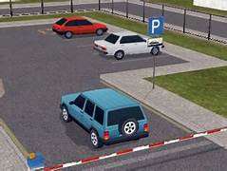
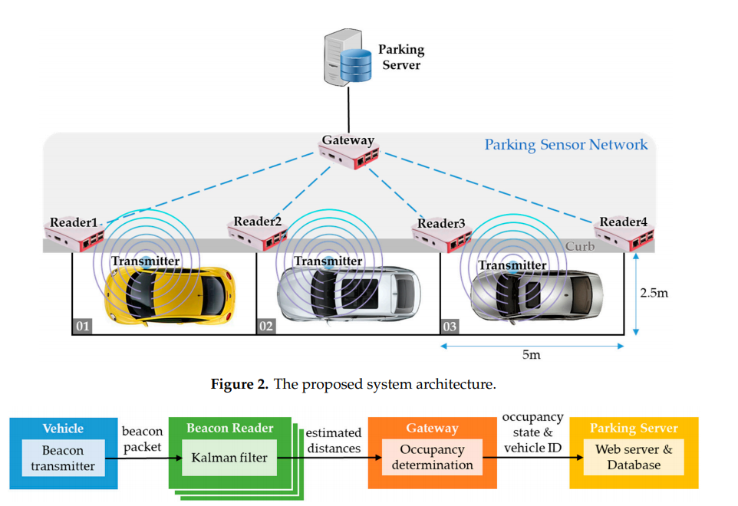
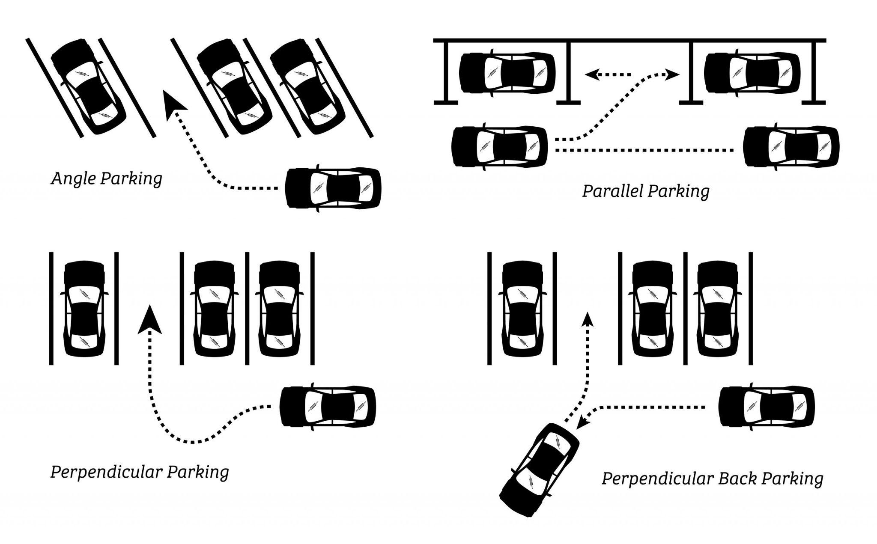
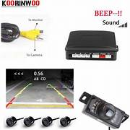
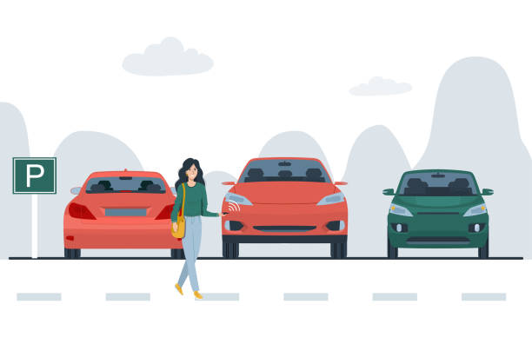
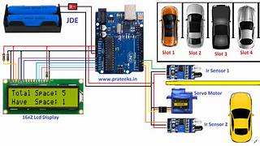
T 13: Storyboard Canvas
v

Slide 19
T14: Concept Synthesis (11 box tool)
Design Challenge: | How might we Automated Parking spot Detection | Solution Concept: | Utilize camera-based sensors and/or ground-based sensors
Persona: watch man,shop owner, vehicle owner needs a parking system that helps them find parking spots quickly and efficiently. | Parking Facilities. Hardware Infrastructure. Real Time Availability. Online Reservations
Deep Needs:Time Optimization: One of the fundamental deep needs for a vehicle parking system is to optimize time for drivers. | Value Propositions to Target users:Find Parking in Seconds: Our smart parking system saves you valuable time by providing real-time updates on available parking spaces near your destination."
Gains:Convenience and easy to use,Saves time. | User Need (Problem)Solvers:Avoiding the stress and frustration of circling around for parking.
Value Propositions to Organizations/ Agency: 1.Optimized Space Utilization: A parking system can maximize the use of available parking spaces, ensuring that every spot is utilized efficiently. 2.Reduced Operating Cost: Automated parking systems can significantly reduce the need for manual labor in managing parking facilities 3.Enhanced Security: Advanced parking systems often include surveillance
Pains:Drivers often waste time searching for available parking spaces | Gain Creators:Parking Guidance and Navigation,Real time updates. | Pain Relievers:Advanced reservation systems

Slide 20
.
T 15: IDENTIFYING QUICK WIN

Slide 21
.
What is this Quick Win(1) about? | Designed to improve the efficiency, convenience, or safety of the parking process for users
What are the success indicator(s)?How would it (these) be measured? | Parking Violation Rates,Occupancy Rate,Turnaround Time,customer satisfaction
What are the resources/staff trainings needed? | Customer Communication,Management and Administration,Staff Training,User Training
Who will lead this Quick Win implementation? | Dr.Balusamy,Kongu Engineering college Principal
What are the key steps needed to implement this Quick Win? What is the timeline till completion? | Train parking attendants, administrators, and users on how to use the system.
When will be the status or progress update? | Get approved by government,raising funds towards the project and working on it by adding some functionalities.
When will this be completed? | 2 Months
How would the success be communicated? | Stakeholder meeting,Public opinion
.

Slide 22
T 16 : ACTION PLANNING TO ADVANCE THE DESIGN CHALLENGE PROJECT
Idea What idea for implementation | Objectives Why is this idea important?Values and benefits | Responsibility Who will lead this? | Implementation How will this be implemented | Resources What capability And resources are needed? | Completion When will this be completed?
Parking process | To reduce the work | Madhuvanthi | Using sensors | Sensors and other electronic devices | 4 week
Mobility process | To reduce time | Kowsalya | AI,servo motors | Ardiuno board,jumpo wires,bread board,IR sensors | 3 week
Rehearsal | To check the working condition and to get feedback | Malini | By testing the vehicle parking system | Expert users | 1 week
.

Slide 23
.
THANK YOU

